Slide 1


Earth System
Model Coupling + Integration

Slide 2

Senior Scientist and Section Head for Terrestrial Sciences, Climate + Global Dynamics Lab, NCAR
PhD, Atmospheric + Ocean Science, Colorado
Expertise
  Earth system modeling
  Land-atmosphere interactions
  Land use change
  Arctic climate feedbacks
Synergistic Activities
  Co-Lead, Community Terrestrial Systems Model
  Co-Chair, Land Use Model Intercomparison Project
  CESM Scientific Steering Committee (2008-2019)

Slide 3

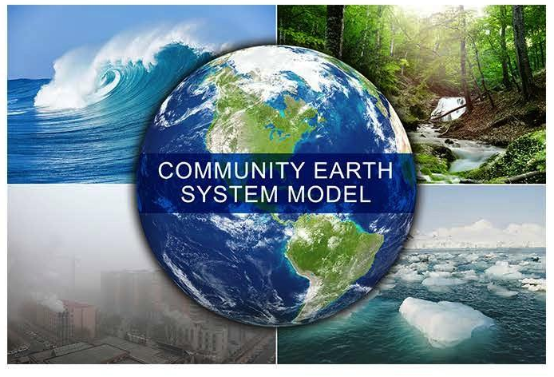

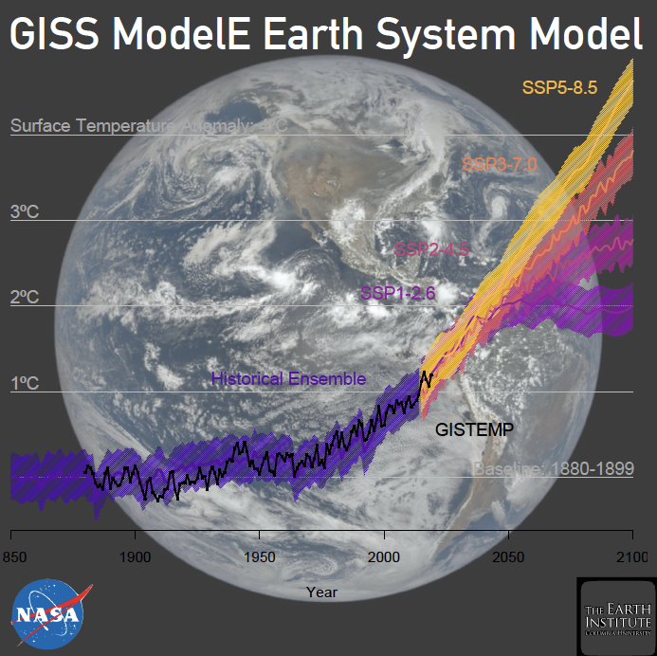

My presentation will explain how
Gavin Schmidt

Slide 4

Our Roadmap
LEAP forward in the reliability, utility, and reach of climate projections through synergistic innovations in data science and climate science.

Slide 5
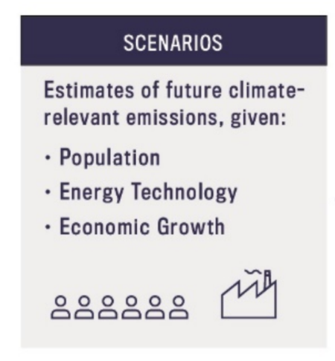
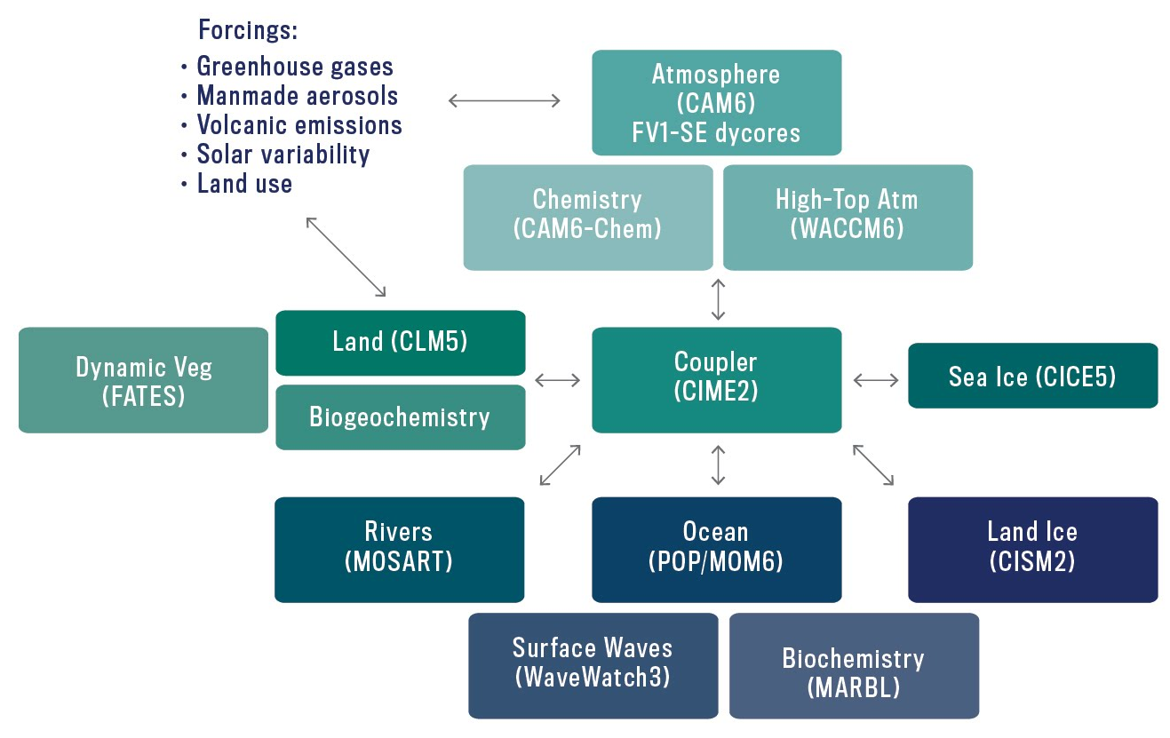
Community Earth System Model (CESM2)
Highly flexible system
Multiple supported resolutions
Data assimilation
> 2 million lines of code
> 1000 geophysical output variables
20+ year legacy of NSF investment

Slide 6
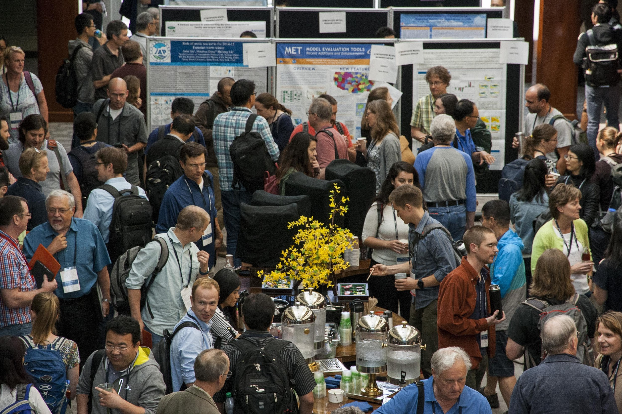
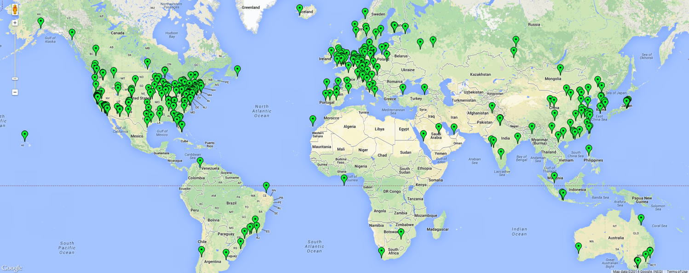
CESM supports a global research community
Workshops and tutorials
Easy-to-use open source model
User support
Publicly available model output
Download of released version since 2010

Slide 7
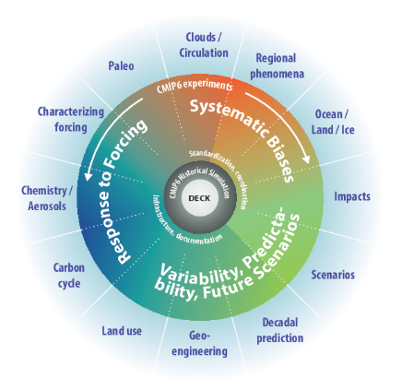
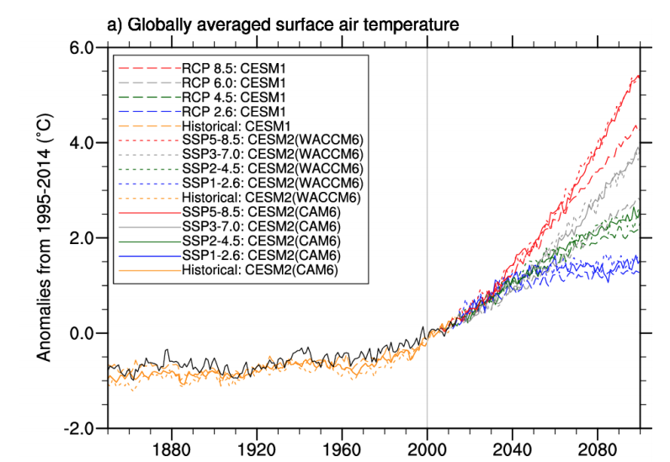
CESM used for wide range of climate research
Coupled Model Intercomparison Project
(CMIP6)
> 1000 model experiments
> 25,000 years of simulation
~2 PB of compressed data

Slide 8


CESM as research tool
Climate variability and change
Earth System prediction
Biogeochemical cycles
Process understanding
Impacts research
…

Slide 9
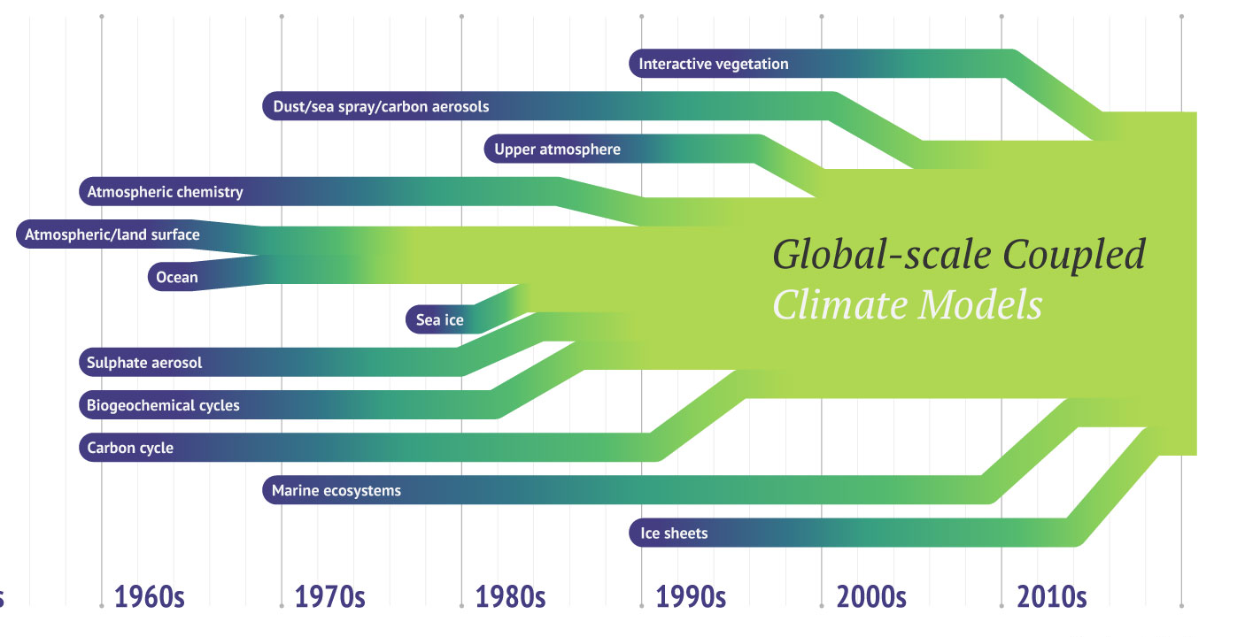
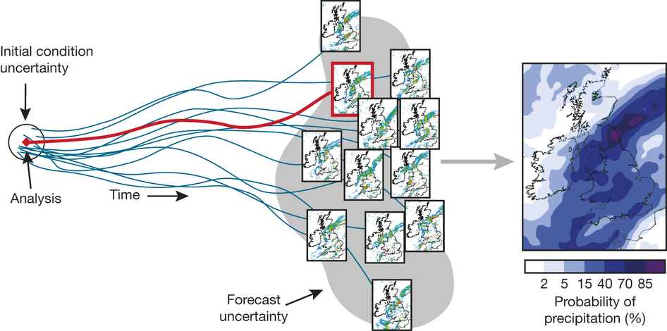
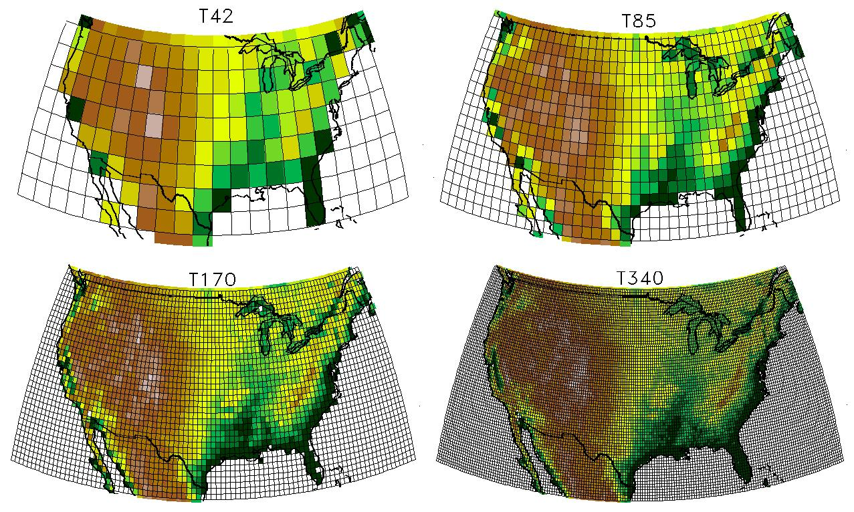
CESM as research tool
Complexity
Resolution
Ensemble Size

Slide 10

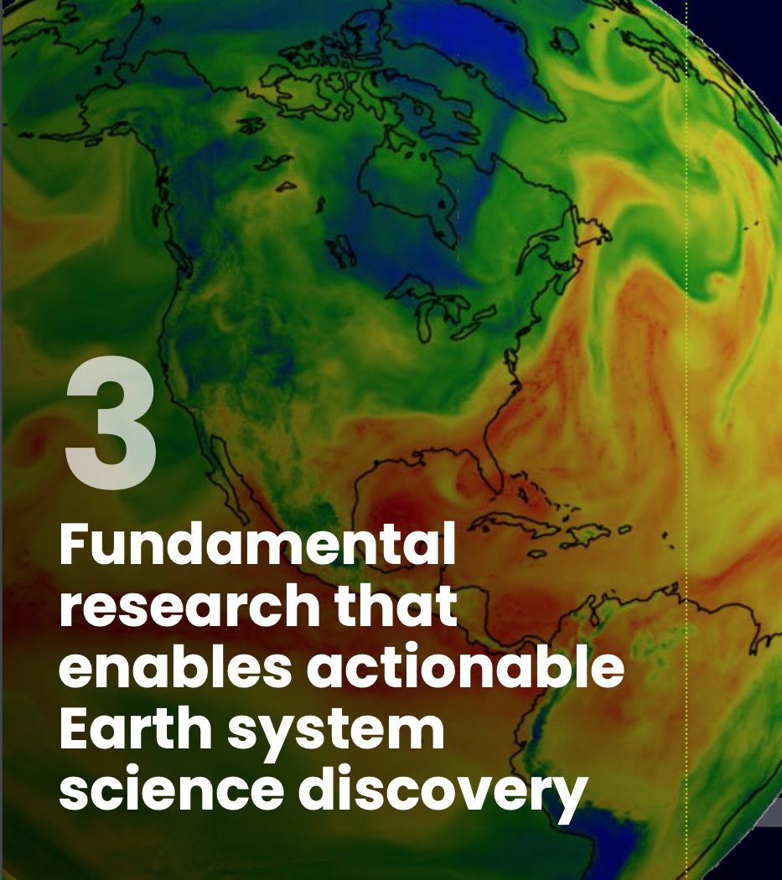
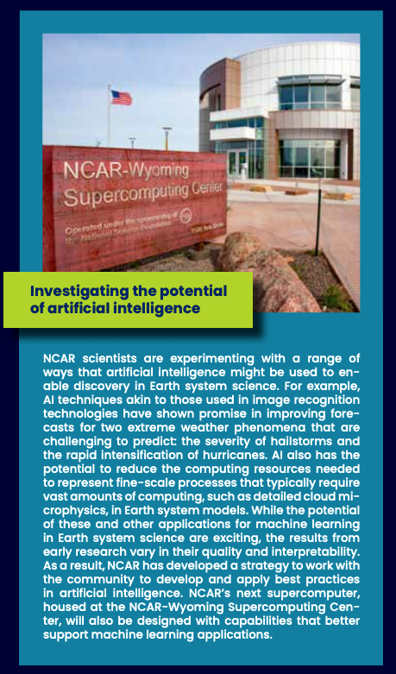
LEAP’s impact on CESM development and research
brings advanced data science into CESM development, consistent with NCAR Strategic Plan priorities
innovates in ways that NCAR could not pursue on own
provides avenue for more reliable Earth System projections and predictions
educates next generation of model developers
will deliver a transformative advance for a significant NSF investment

Slide 11
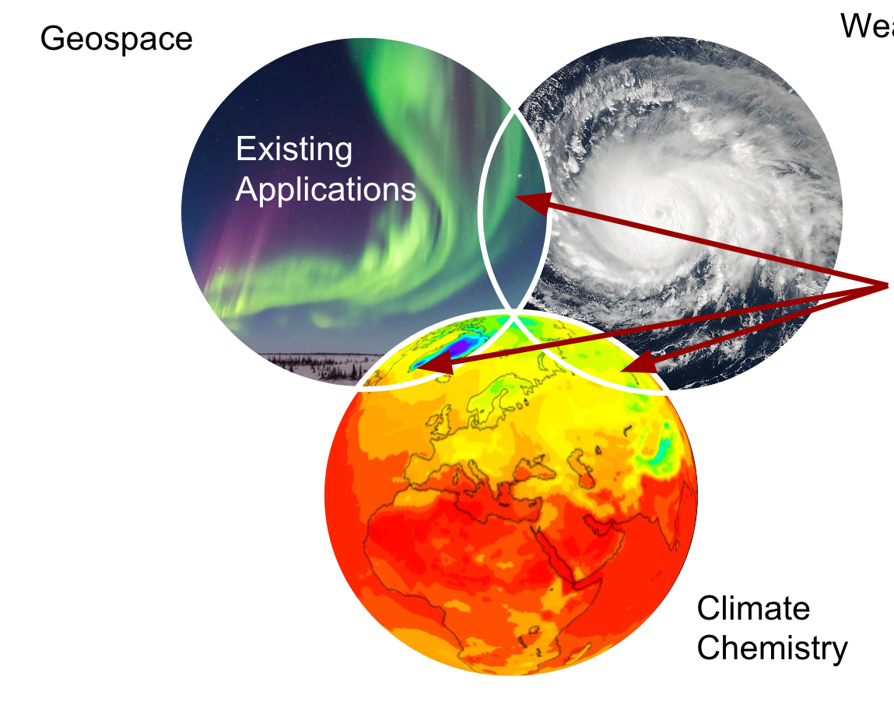
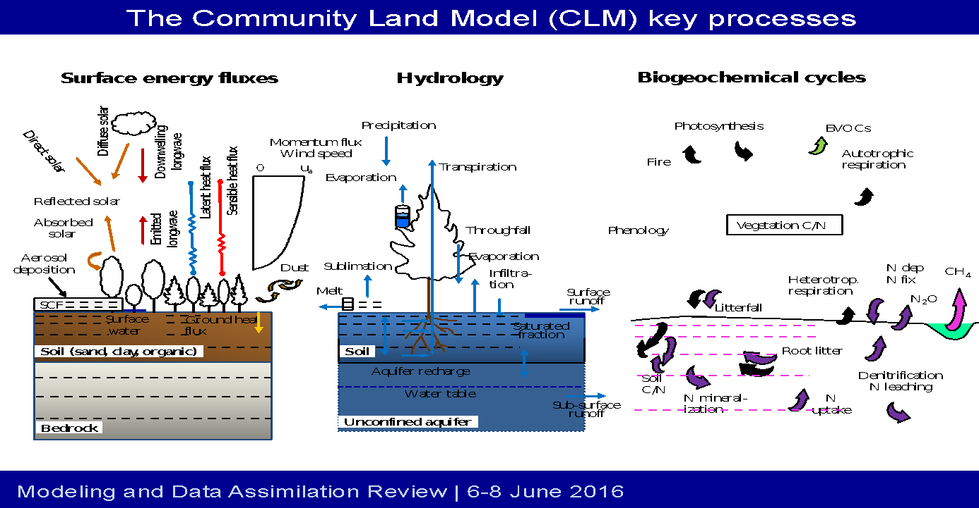
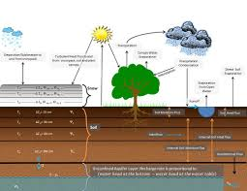
LEAP’s impact will extend beyond climate modeling
NCAR transition to unified modeling systems
SIMA
System for Integrated Modeling of the Atmosphere
CTSM
Community Terrestrial Systems Model
Weather
CLM
climate
SUMMA concepts
CTSM
Noah-MP
weather, hydrology

Slide 12
LEAP – NASA GISS ModelE partnership
Most promising LEAP advances will be tested in ModelE as well as CESM
Assessment in multiple models yields insight about impact and robustness of ML parameterizations in context of structural uncertainty
Take advantage of existing relationships between LEAP and GISS scientists

Slide 13
LEAP integration into CESM development process
LEAP scientists will participate in CESM Working Groups
Short- and long-term collaborative visits to NCAR
Dedicated software engineering supported by LEAP to integrate LEAP code into CESM
Scientific support from NCAR staff scientists in LEAP team
Biogeo-
Chemistry
Polar
Climate
Land
Ice
Atmosphere
Model
Earth
System
Prediction
Chemistry-
Climate
Paleo-
Climate
Whole
Atmosphere
Land
Model
Ocean
Model
CESM
Climate
Variability
and
Change

Slide 14
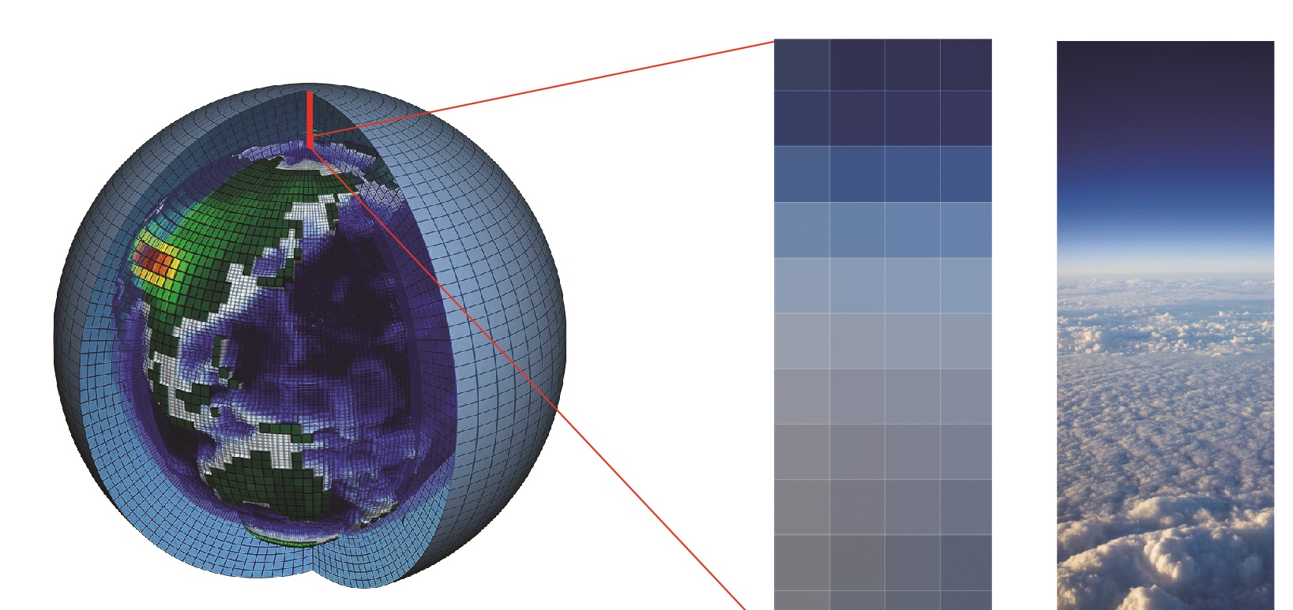
LEAP integration into CESM development process
Model release (CESM2)
Model release (CESM3)
Model assessment (identify strengths and weaknesses)
Document; Control integrations
WG members develop parameterizations or add features
Test and tune within coupled system
New physics-guided ML algorithm
Present ideas/results at WG meetings
Interim release (CESM2.X)
Use for scientific
Publish papers
Evaluate competing parameterizations
Full code integration
Test in updated component model

Slide 15
Compatibility with other new developments
Developments for Community Land Model (CLM5)
Flexible leaf stoichiometry
Leaf N optimize for photosynthesis
Carbon costs for plant N uptake
Plant hydraulics w/ hydraulic redistribution
Spatially explicit soil depth
Dry surface layer, revised groundwater
Revised canopy interception
MOSART river model (hillslope 🡪 tributary 🡪 main channel)
Canopy snow storage and radiation
Fresh snow density (T, wind)
Simple firn model
Global crop model (8 crop types)
Transient irrigation and fertilization
Dynamic landunits (nat veg 🡨🡪 crop, glacier 🡨🡪 nat veg)
Urban heating and AC, heat stress indices
Deforestation, cropland fire
New PFT and CFT distributions
Carbon isotopes
Coupled fire trace gas emissions
Ecosystem demography (FATES),
Ozone damage to plants
Shifting cultivation
Lawrence et al., 2019

Slide 16
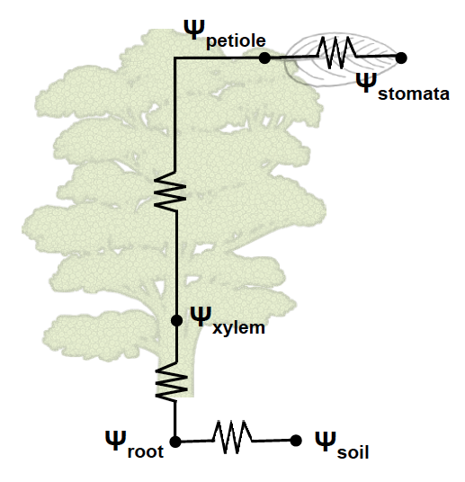
Compatibility with other new developments
Developments for Community Land Model (CLM5)
Implementing plant hydraulics
Collaboration with Pierre Gentine’s student
2+ year process
Many interdependencies needed to be resolved
Flexible leaf stoichiometry
Leaf N optimize for photosynthesis
Carbon costs for plant N uptake
Plant hydraulics w/ hydraulic redistribution
Spatially explicit soil depth
Dry surface layer, revised groundwater
Revised canopy interception
MOSART river model (hillslope 🡪 tributary 🡪 main channel)
Canopy snow storage and radiation
Fresh snow density (T, wind)
Simple firn model
Global crop model (8 crop types)
Transient irrigation and fertilization
Dynamic landunits (nat veg 🡨🡪 crop, glacier 🡨🡪 nat veg)
Urban heating and AC, heat stress indices
Deforestation, cropland fire
New PFT and CFT distributions
Carbon isotopes
Coupled fire trace gas emissions Ecosystem demography (FATES),
Ozone damage to plants
Shifting cultivation
Lawrence et al., 2019; Kennedy et al., 2019

Slide 17
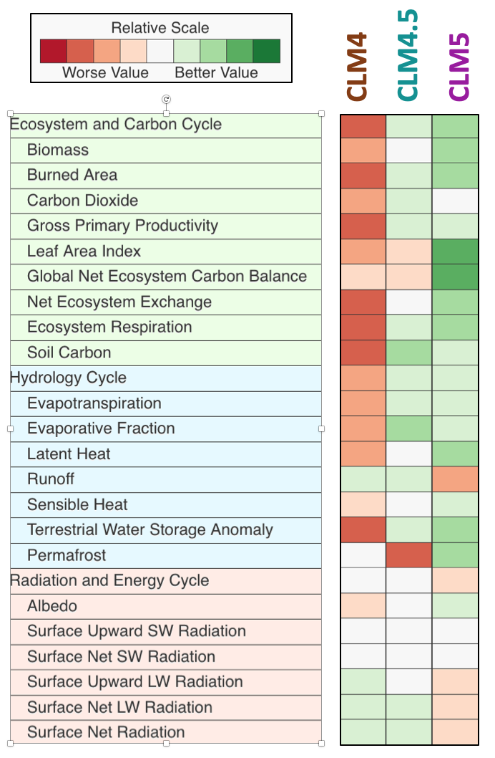

Model performance tracking
Standardized metrics for evaluation
Climate variability diagnostics package (CVDP)
CESM component model diagnostics packages
International Land Model Benchmarking (ILAMB)
ESMValTool
…
New LEAP machine-learning based metrics derived from big data
Lawrence et al., 2019

Slide 18
LEAP integration into CESM development process
Model release (CESM2)
Model release (CESM3)
Model assessment (identify strengths and weaknesses)
Document; Control integrations
WG members develop parameterizations or add features
Test and tune within coupled system
New physics-guided ML algorithm
Present ideas/results at WG meetings
Interim release (CESM2.X)
Use for scientific
Publish papers
Evaluate competing parameterizations
Full code integration
Test in updated component model

Slide 19

LEAP integration into CESM development process
Model release (CESM2)
Model release (CESM3)
Model assessment (identify strengths and weaknesses)
Document;
Control integrations
WG members develop parameterizations or add features
Test and calibrate within coupled system
Present ideas/results at WG meetings
Finalize and calibrate component models
Use for scientific
Publish papers
Risk mitigation
Evaluate competing parameterizations
Full code integration
Test in updated component model

Slide 20
LEAP integration into CESM development process
Model release (CESM2)
Model release (CESM3)
Model assessment (identify strengths and weaknesses)
Document;
Control integrations
WG members develop parameterizations or add features
Test and calibrate within coupled system
Bayesian parameter estimation
Present ideas/results at WG meetings
Finalize and calibrate component models
Use for scientific
Publish papers
Evaluate competing parameterizations
Full code integration
Test in updated component model

Slide 21
LEAP provides transformative advances in Earth System Modeling for the NSF-supported CESM
Partnership with NCAR ensures that LEAP development is integrated into CESM for community use

Slide 22
Questions? Feedback?

Slide 23
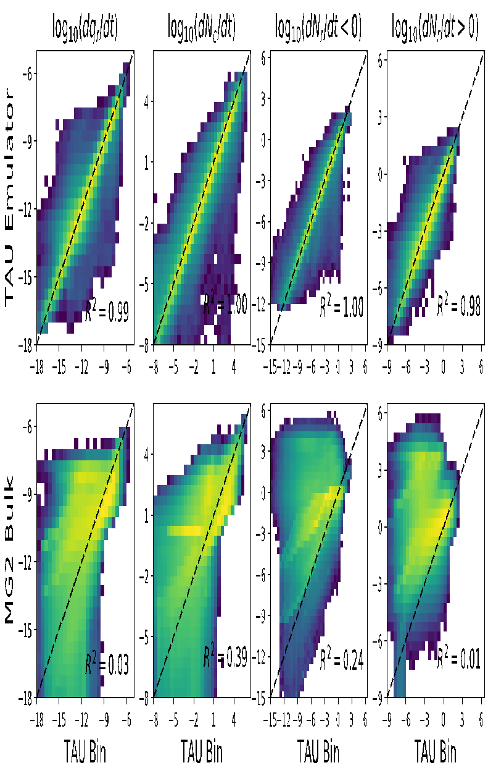
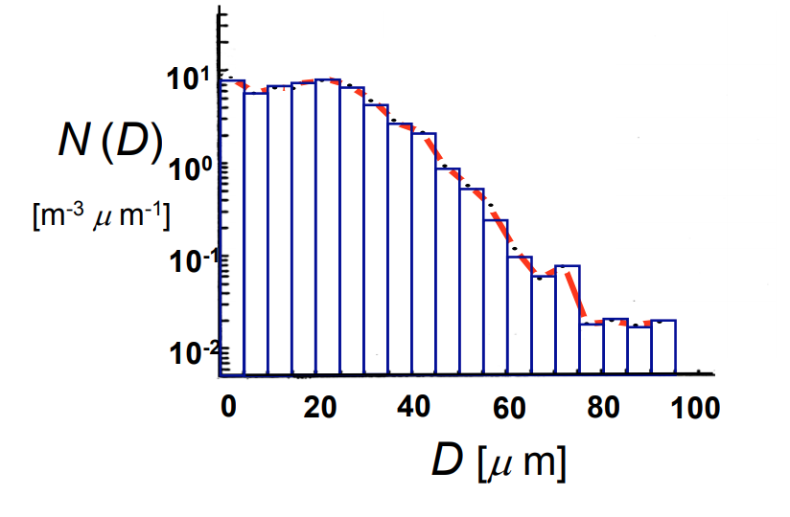
ML parameterization pilot study in CESM
Example
Can we do the warm rain process better?
Replace BULK precipitation processes with detailed treatment from BIN microphysics code.
Run inside CAM, then emulate results
Preliminary Results: ML code works, is pretty well optimized, reproduces detailed code
NCAR has a small Machine Learning group (led by David Gagne, also in LEAP) and some pilot projects, including with CESM
We have learned a few things about how to integrate ML code into CESM with pilot. This presents opportunities, but we have not solved all the challenges (LEAP will help!)
NCAR is Primed with basic infrastructure in CESM to do this and have an example (cloud microphysics, shown) which is interesting and being evaluated now
Pilot suggests ML work in CESM low risk, but high opportunity to advance further
BIN
BULK

Slide 24
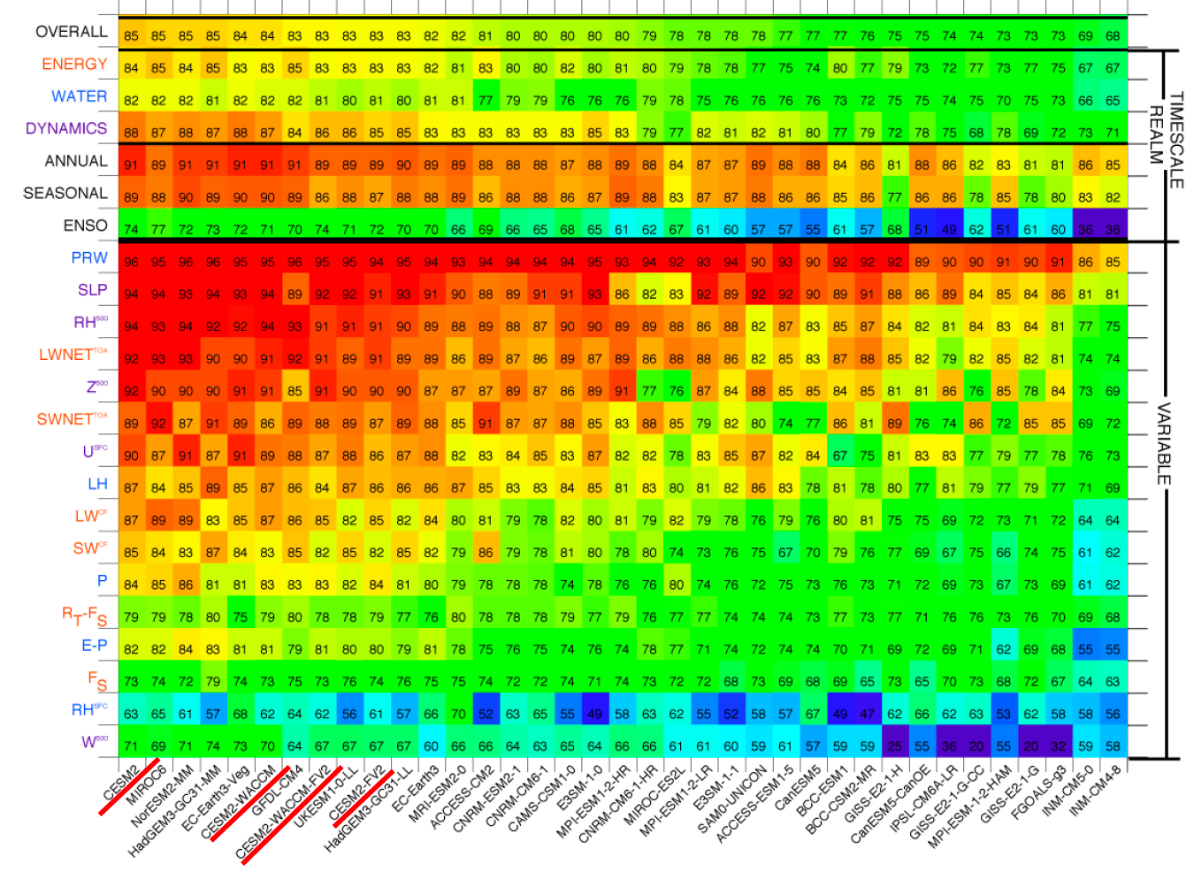
Assessing quality of CESM simulations
CESM is among best performing models, but …
Persistent biases and other limitations remain
Stakeholders struggle to effectively understand and use model data
Model Assessment Toolkit

Slide 25
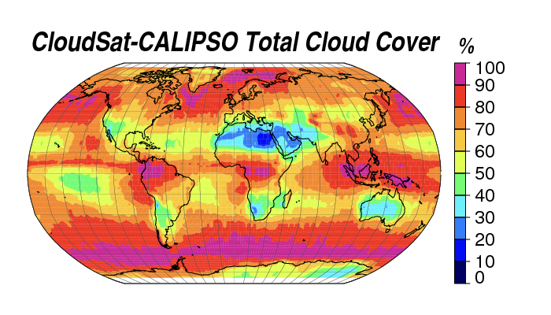
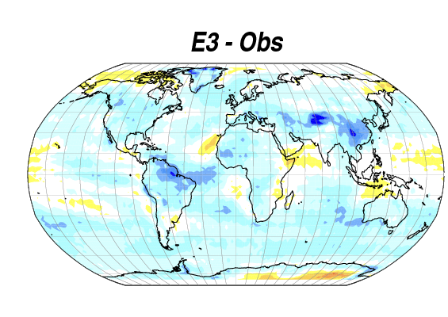
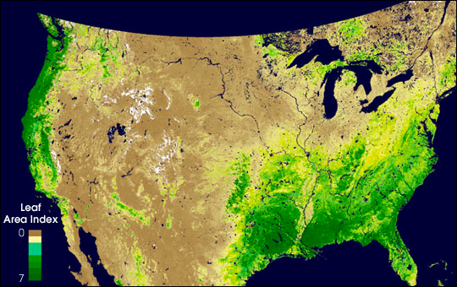
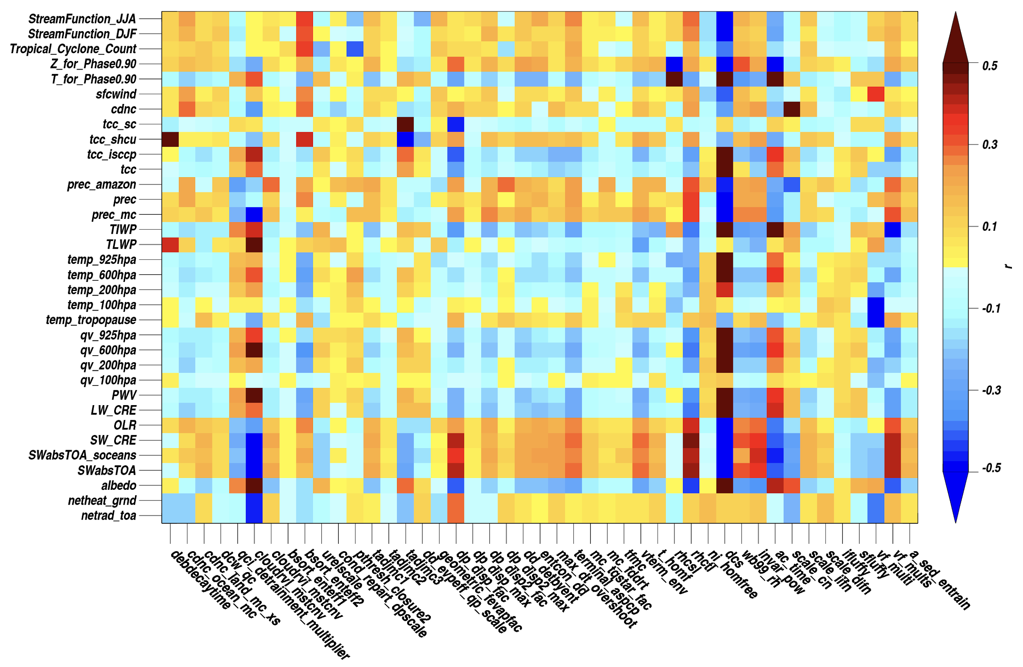
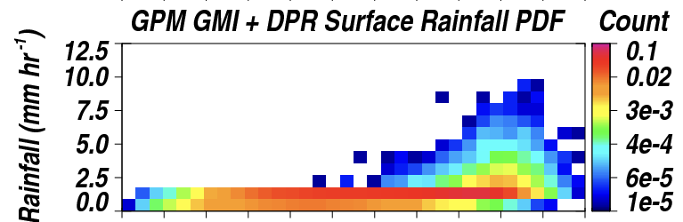
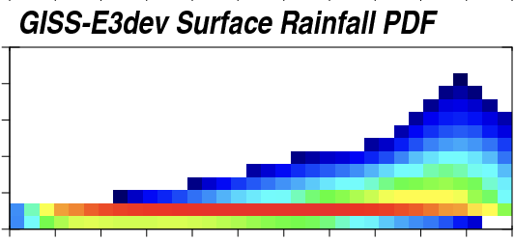
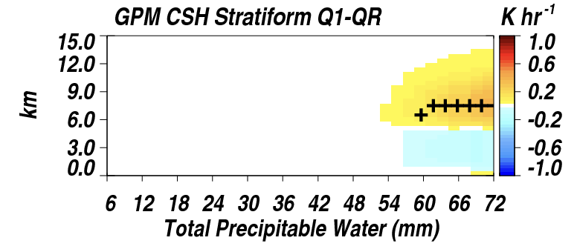
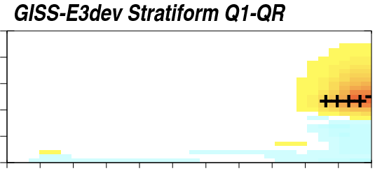
GISS Modeling is unique in how it uses NASA data
Land surface properties topography, emissions
Model inputs
Global and regional evaluation across multiple variables & teleconnections
Model evaluation
Parameterization development
Process-related diagnostics from low earth orbit and flight campaigns
Global tuning
Perturbed physics ensembles plus Machine Learning to match satellite metrics (with uncertainties) across 40+ model parameters

Slide 26
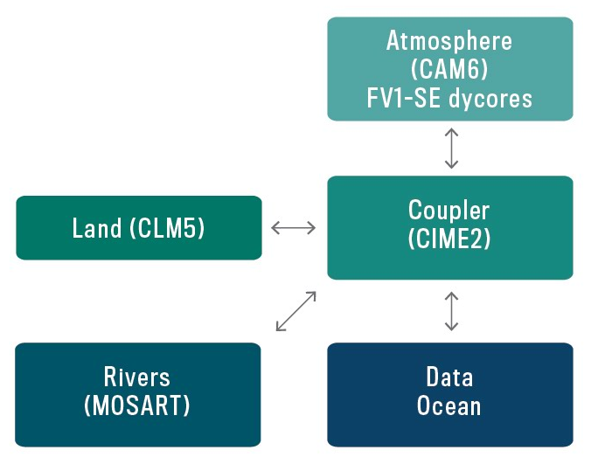
Community Earth System Model (CESM2)
Highly flexible system

Slide 27
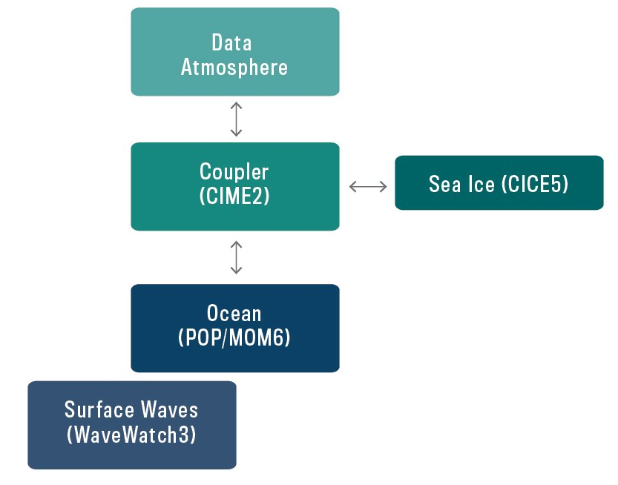
Community Earth System Model (CESM2)
Highly flexible system

Slide 28
Questions? Feedback?

